Slide 1
Body Fat % Prediction
Presenters (Group 09):
Kanishk Saxena
Pushpit Kaushik
Yu Luan
Under the guidance of:
Prof. Hyunseung Kang

Slide 2
Problem Statement
Simple, robust, and accurate model to estimate percentage of body fat using clinically available measurements.
Real data set of 252 men.
Measurements of their percentage of body fat and various body circumference measurements.
Make some trade-offs between simplicity, robustness, and accuracy in our final model.

Slide 3
Background
Body fat % can be estimated using age and various skin-fold measurements obtained by using a caliper.
Percentage of body fat for an individual can be estimated once body density has been determined. Volume and therefore body density, can be accurately measured a variety of ways.
There is a technique of underwater weighing which helps to calculate body density.
Unfortunately, the process of determining body volume by underwater submersion, while accurate is cumbersome and difficult.

Slide 4
Data Cleaning
1. Identifying & Removing Impossible Values
Context: Body fat percentages beyond the physiological range (below 2% or above 50%) are considered impossible.
Action: Identified entries with impossible body fat percentages based on the original column and formula: Percentage of Body Fat = 495/D - 450. (D - Density)
Result: Removed entries with IDNO 96, 172, 182 due to impossible body fat values.

Slide 5
Data Cleaning
2. Removing Irrelevant Columns
'IDNO' is just an identifier.
'DENSITY' is used to calculate 'BODYFAT' and thus would perfectly predict it, which is not useful for our predictive model.
'ADIPOSITY' is directly calculated from 'WEIGHT' and 'HEIGHT', making it redundant.

Slide 6
Model Selection
Our goal is to build a simple, accurate and robust model. Our decision is linear model to fit the data.
Reasons:
Simplicity & Interpretability:
Linear models are straightforward to understand and interpret.
They provide clear insights into the relationship between variables.
Performance:
Despite their simplicity, linear models can perform exceptionally well for predicting outcomes.
They are particularly effective when the relationship between predictors and outcome is approximately linear.

Slide 7
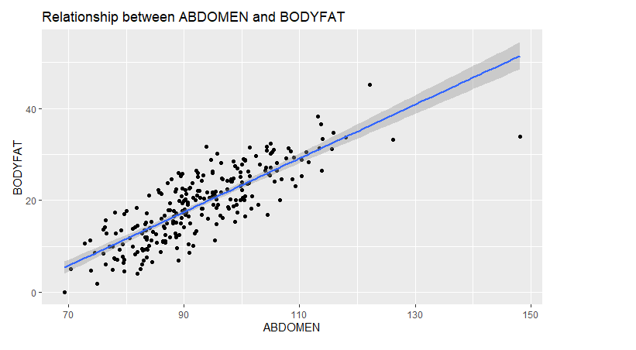
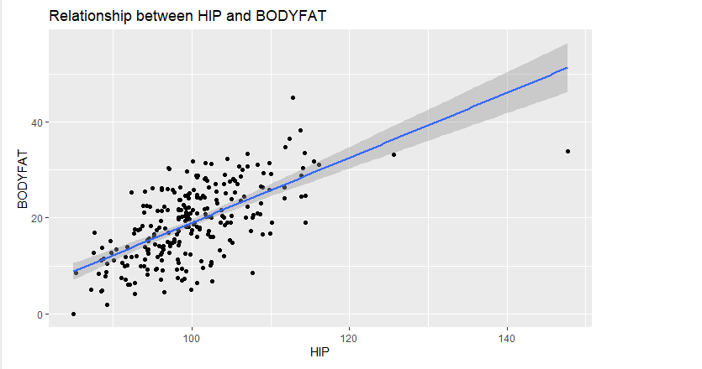
Model Selection
linear relationship between some features like abdomen or hip and the bodyfat is very obvious.
Notes:
How to interpret the plot

Slide 8
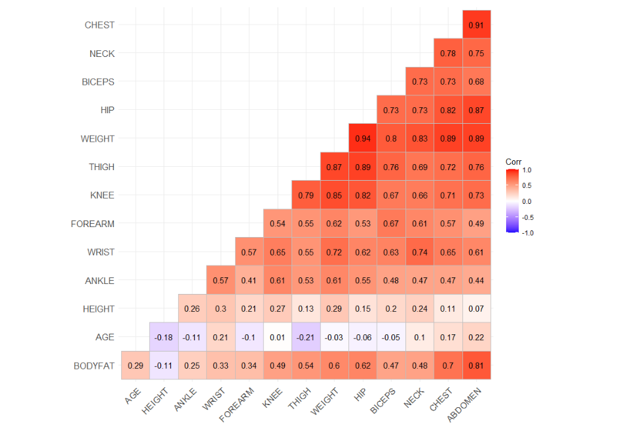
Model Fitting
Step 1 Using Pearson to select important features
With many potential predictors, it's impractical and inefficient to include all, as this can lead to overfitting and multicollinearity, reducing the model's ability to interpret. So We used Pearson's correlation coefficient to identify the variables most strongly linearly related to body fat.

Slide 9
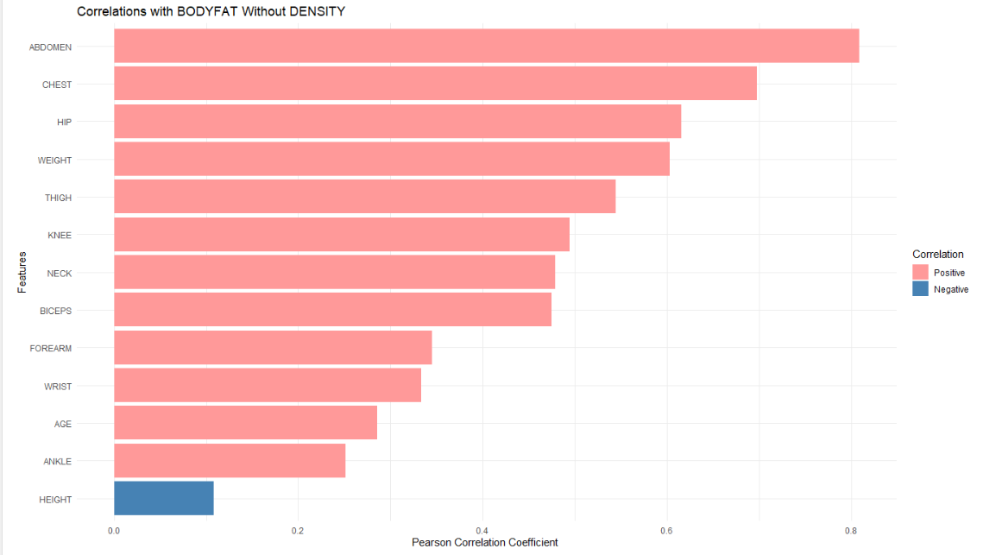
Model Fitting
We choose the threshold for our model is 0.5. So the potential features for our final model are ABDOMEN, CHEST, HIP, WEIGHT, THIGH.

Slide 10
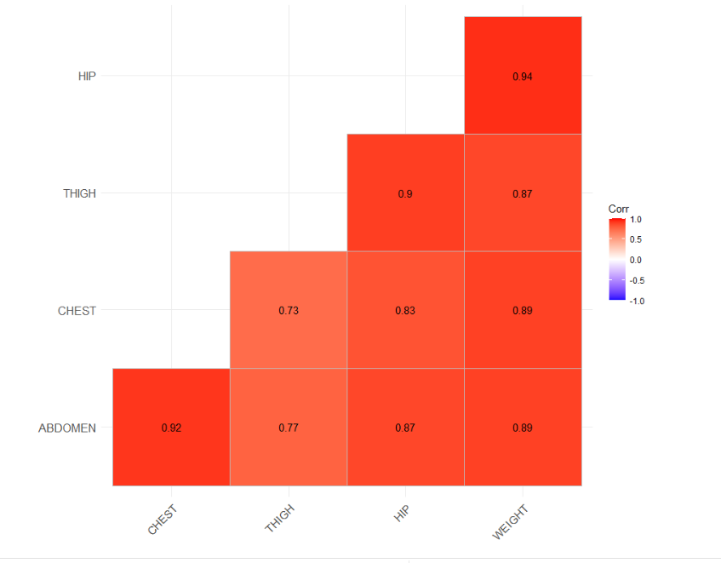
Model Fitting
Step2 :Recursive Feature elimination (RFE)
From the Pearson correlation matrix, we identified that several potential predictors are strongly correlated with 'BODYFAT'. However, these predictors are also inter-correlated, leading to multicollinearity if included together in a model.
The solution: RFE helps in this scenario by selecting not just the features that predict well, but also those that contribute to a model that predicts well together. RFE can effectively reduce the number of variables in the model while maintaining a high level of predictive power.

Slide 11
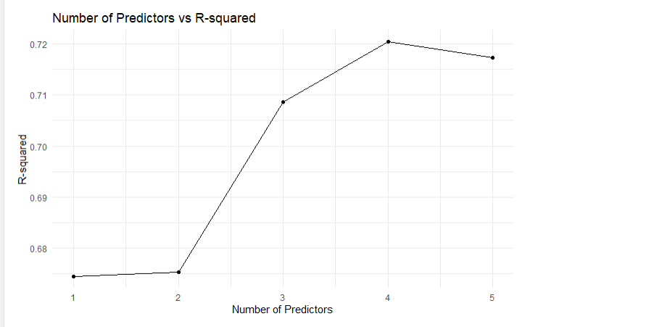
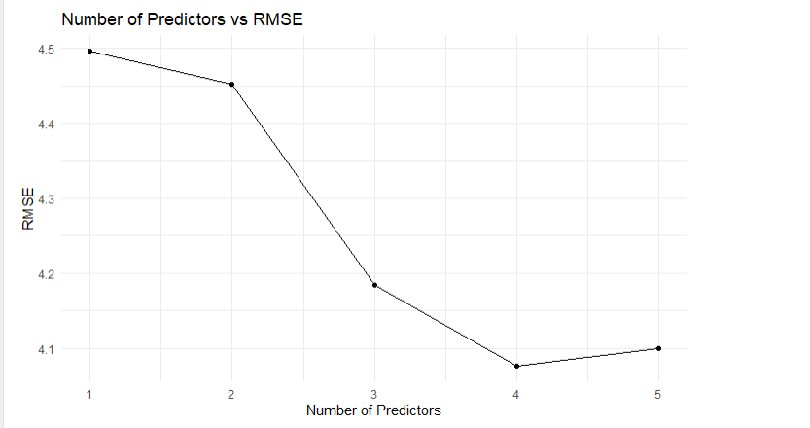
Model Fitting
RFE helps us to eliminate the CHEST

Slide 12
Model Evaluation and Final Selection
Based on RFE, model performance, and consideration of multicollinearity, we narrowed down our predictors to ABDOMEN, THIGH, WEIGHT, HIP." For the robustness goal, we split the data set into training and testing to find out our final decision.
 | RMSE | R-Squared
Full model | 4.199 | 0.734
ABDOMEN + THIGH + WEIGHT + HIP | 4.131 | 0.715
ABDOMEN + THIGH + WEIGHT | 4.142 | 0.714
ABDOMEN + THIGH | 4.210 | 0.663

Slide 13
Conclusion
Our final model is:
BODYFAT = -46.673 + 0.913 * (ABDOMEN) + 0.192 * (THIGH) - 0.169 * (WEIGHT)
How can we interpret this formula?
What are other factors (added information) that can help us identify flaws in this model?
Let’s take a look at the performance of the model in the form of a Shiny app.

Slide 14
DEMO
Notes:
Take 2 minutes for demo

Slide 15
Thank You

